Slide 1
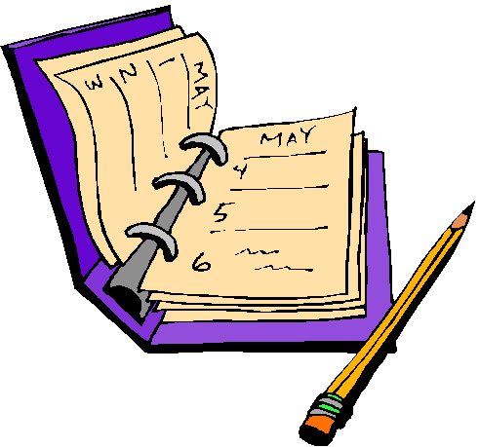
Dear diary…
Today was …
I went to …
I saw …
I heard…
I felt …

