Slide 1
Strategies to improve writing

Slide 2
Notes:
Elicit from students what people in the pictures are doing.
When speaking (spontaneously) we focus on the actions we see. Use verbs to describe them

Slide 3
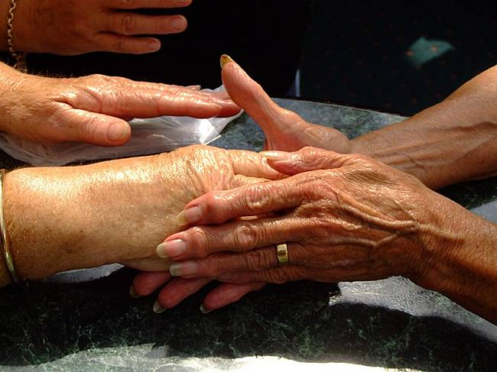
Which is the more formal sentence?
It is important for health professionals to consider different cultures.
The consideration of different cultures is important.
Notes:
Compare the two sentences. What has changed? What is the effect?
Model for students how you changed the sentence. Reflect the change of tone in your voice.
The second is less immediate, less ‘spoken’. The tone has become more distant and academic

Slide 4
Which is the more formal sentence?
Balancing the requirements of different faiths can be complex.
The complexity of balancing the requirements of different faiths can be considerable.
Notes:
Same procedure as previous slide, but explain that adjectives can also be changed.

Slide 5
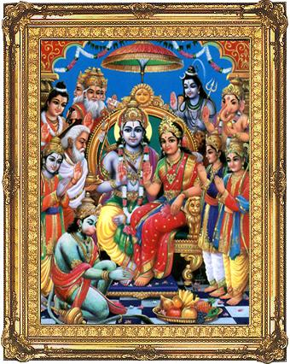
Which is the more formal sentence?
Modern Hindus might disagree with a traditional Hindu perspective because they say society has changed.
Disagreement between modern and traditional Hindu perspectives arises as society changes.
Notes:
Students attempt to change this sentence focusing on the verb ‘disagree’.
Compare their suggestions before showing your version.

Slide 6
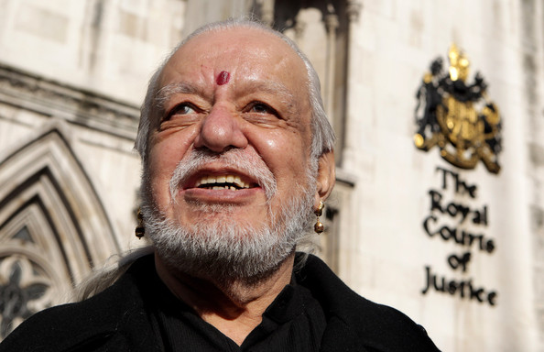
He is deeply devoted.
His devotion is deep.
His deep devotion impressed all who knew him.
Davender Ghai

Slide 7
expect
marry
agree
dictate
enter
liberate
attain
procreate
abusing
live
devoted
think
affect
fulfil
consistent
celibate
complex
suffer
Notes:
Verbs from essay on Death in Hindu community.
Students may attempt changing a selection in the context of the essay. Do they think the results are an improvement?

